Slide 1
Exception Handling

Slide 2
Exception Handling
Exception handling is the process of responding to unwanted or unexpected events when a computer program runs.
Exception handling deals with these events to avoid the program or system crashing, and without this process, exceptions would disrupt the normal operation of a program.
Exceptions occur for numerous reasons, including invalid user input, code errors, device failure, the loss of a network connection, insufficient memory to run an application, a memory conflict with another program, a program attempting to divide by zero or a user attempting to open files that are unavailable.

Slide 3
When an exception occurs, specialized programming language constructs, interrupt hardware mechanisms or operating system interprocess communication facilities handle the exception.
Exception handling differs from error handling in that the former involves conditions an application might catch versus serious problems an application might want to avoid. In contrast, error handling helps maintain the normal flow of software program execution.

Slide 4
How is exception handling used?
If a program has a lot of statements and an exception happens halfway through its execution, the statements after the exception do not execute, and the program crashes.
Exception handling helps ensure this does not happen when an exception occurs.

Slide 5
Runtime stack mechanism:
For every thread JVM will create a runtime stack.
each and every method call performed by that thread will be stored in the corresponding stack.
each entry in the stack is call stack frame are activation record.
After completing every method call the corresponding entry from the stack will be removed.
after completing all method call stack will become empty and the empty stack will be destroyed by JVM just before terminating the thread.

Slide 6
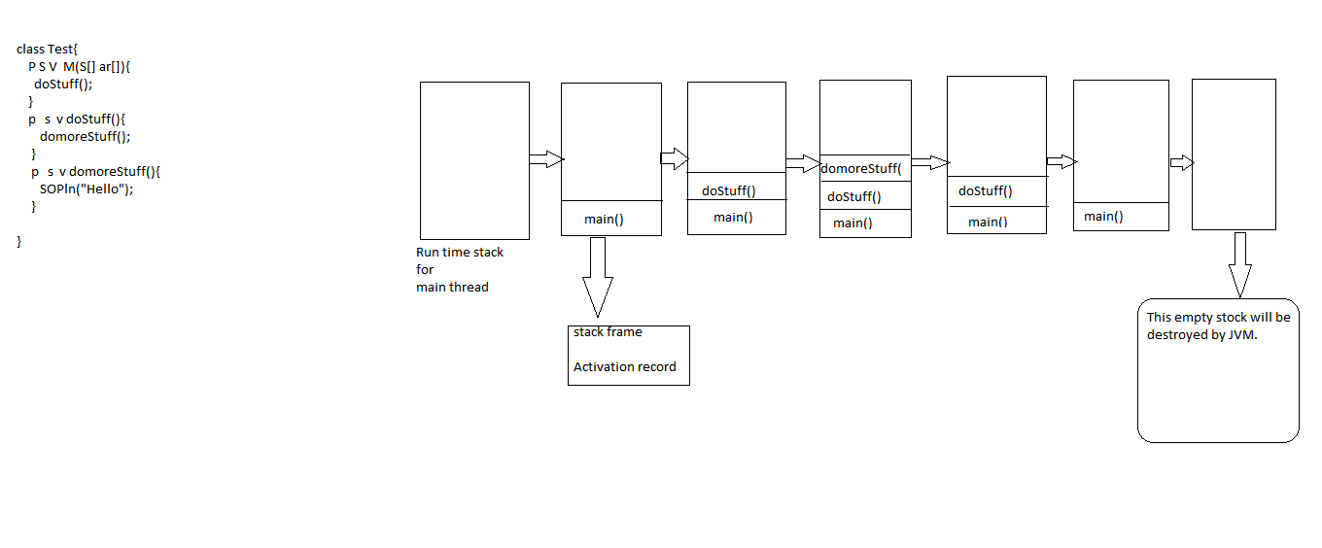

Slide 7
Default Exception Handling
Inside a method, if any exception occurs the method in which it is raised is responsible to create an exception object by including the following information.
Name of exception
Description of exception
Location at which exception occurs[Stack trace]
After Creating exception object methods handovers that object to the JVM.

Slide 8
JVM will check whether the method contains any exception handling code or not if the method doesn’t contain exception handling code then JVM terminates that method abnormally and removed the corresponding entry from the stack
Then JVM identifies the caller method and checks whether the caller method contains any handling code or not.
If the caller method doesn’t contain handling code then JVM terminates that caller method also abnormally and removes the corresponding entry from the stack.

Slide 9
This process will be continued until main method and if the main method also doesn’t contain handling code than JVM terminates main method also abnormally and removes corresponding entry from the stack.
Then JVM handovers responsibility of exception handling to default exception handler, which is the part of JVM.
Default exception handler prints exception information in the following format and terminates program abnormally.
Exception in thread “XXX”: Name of exception: Description Stack Trace

Slide 10
In a program if at least one method terminates abnormally then the program termination is abnormal termination.
If all method termination normally the only program termination is normal termination.

Slide 11
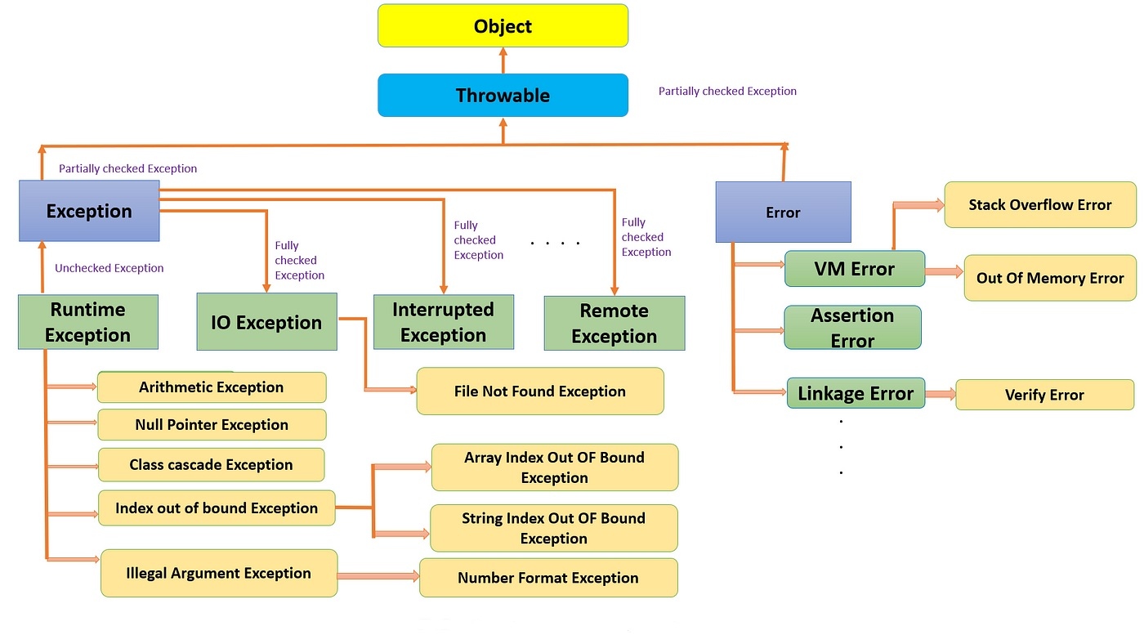
Exception Hirarchy

Slide 12
Exception
Most of the times exception are caused by our program and these are recoverrable.
Example: if our prgramming to read data from remote file locating at london at runtime if remote file is not available then we will get runtime exception saying FileNotFoundException .
If FileNotFound exception occurs we can provide a local file and continue the rest of the program normally.
try{
Read data from remote file locating at london
}
catch(FileNotFoundException e){
use local file and continue rest of the program normally
}

Slide 13
Error
Most of the time Error are not caused by our program and these are due to lack of system resources.
Errors are non-recorrable.
Example: if OutOfMemory Error occurs being a programmer we can't do anything and program will be terminated abnormally.
System admin or server admin is responsible to increase heap memory.

Slide 14
Checked and Unchecked Exception
Checked Exception:
The Exception which are checked by compiler for smooth execution of the program at runtime are called checked exception.
Example: HallTicketMissingException, PenNotWorkingException, FileNotFoundException, etc.
In our program if there chance of rising checked exception then compulsury we should handle the checked exception(either by try catch or throws keyword) other wise we will get compile time Error.

Slide 15
Unchecked Exception:
The exception which are not checked by compiler wheather programmer handling or not such type of exception are called Unchecked exception.
Example: AirthmeticException, ArrayIndexOutOfBoundsException, etc.
1. Wheather it is checked or unchecked every exception occurs yet runtime only there is no chance of occuring any exception get compiletime.
2. Runtime exception and its child classes, error and its child classes are unchecked except these remaining are checked.

Slide 16
Fully checked vs Partially checked
A checked exception set to be fully checked if and only if all its child classes are also checked.
Example:IOException InturruptedException etc
The checked exception is set to be partially checked if and if some of its child classes are unchecked.
Example: Exception, Throwable
NOTE: The only possible partially checked exception in java are:
Exception
Throwable

Slide 17
Behaviour of following Exception
IOException ----> Checked(Fully checked)
RuntimeException--> Unchecked
InterruptedException--->Checked(Fully)
Error--->Unchecked
Throwable-->Checked(Partially)
ArithmeticException--->Unchecked
NullPointerException-->Unchecked
Exception--->Checked(Partially)
FileNotFoundException--->Checked(Fully)

Slide 18
Customizer exception handling by using try catch
without try catch
class Test{
p s v main(String args[]){
Sop("Hello");
Sop(10/0);
Sop("Hi");
}
}
Abnormal Termination

Slide 19
With try catch
class Test{
p s v main(String args[]){
Sop("Hello");
try{
Sop(10/0);
}catch(AirthmeticException e){
Sop(10/2);
}
Sop("Hi");
}}
Normal Termination

Slide 20
It is heighly recommended to handle exceptions
The code which may rise an exception is called risky code and we have defined that code inside try and corresponding handling code we have defined inside catch block.
try{
Risky code
}
catch(Exception e)
{
Handling code
}

Slide 21
Method to print Exception information
Method | Printable Format
printStackTrace() | Name of exception: Description Stack Trace
toString() | Name of exception: Description
getMessage() | Description
Internally default exception handler will use print stack trace method to print exception information to the console.

Slide 22
Example
class Test{
p s v main(String[] args){
try{
Sop(10/0);
}
catch(AirthmeticException e)
{
e.printStackTrace(); //java lang AE : / by zero at Test main()
Sop(e.toString()) or Sop(e); // java lang AE: / by zero
Sop(e.getMessage()); // / by zero
}}}

Slide 23
Try with multiple-catch blocks:
The way of handling exceptions is wired from exception to exception hence for every exception type it is highly recommended to take separate catch block that is try with the multiple-catch block is always possible and recommended to use.

Slide 24
Wrost Programming Practice
try{
Risky Code
}
catch(Exception e){
}

Slide 25
Best prgramming Practice
try{
Risky code
}
catch(AirthmeticException e){
Perform alternative arithmetic operation
}
catch(SQLExceptionn e){
Use mySQL db instead of oracle db
}
catch(FileNotFoundException e){
Use load file instead of remote file
}
catch(Exception e){
default exception handling
}

Slide 26
Final
final is a modifier applicable for classes methods and variables.
If a class declare as final than we can't extend that a class that is we can't create child class for that class.Inheritance is not possible for final classes.
If a method is final than we can't override that method in the child class.
If a variable declare as final than we can't perform reassignment further variable.

Slide 27
Finally
Finally is a block always associated with try catch to maintain cleanup code.
The speciality of finally block is it will be executed always respective of either exception is raised or not raised or handling not handle.
try{
Risky code
}
catch(Exception e){
Handling code
}
finally
{
cleanup code
}

Slide 28
Finalize()
finalize() is a method always invoked by Garbage collector just before distroying an object to perform cleanup activities.
Once finalize method completes immedietlly garbage collector distroy that object.
finally block is responsible to perform cleanup activities related to try block that is whatever resources we opened at the part of try block will be closed inside finally block.
Whereas finalize() is responsible to perform cleanup activaties related to object that is whatever resources associated with object will be deallocated before destroying an object by using finalize method.

Slide 29
Important ponts
In try-catch-finally order is important.
Whenever we are writting try compulsury we should write either catch or finally other wise we will get compile time error that is try without catch or finally is invalid.
Whenever we are writting catch block compulsary try block must be required that is catch without is invalid.
Whenever we are writting compulsary we should write try block that is finally without try is invalid.
Inside try-catch-finally block we can declare try catch and finally blocks that is nesting of try-catch-finally is allowed.
For try-catch-finally blocks curly braces are mendatory.

Slide 30
throw and throws
Sometimes we can be creating exception object explicitly that we can handover to the JVM manually for these we have to use the throw keyword.
throw(Hand-over our created object to the JVM manually)
throw new ArithmeticException("/ by zero") //Creation of AirthmeticException Object explacitly.
class Test{ class Test{
p s v m(S[] args){ p s v m(S[] args){
Sop(10/0); throw new AF(“/ by zero”);
}} }}
Note: Best use throw keyword is for user defined exceptions or customized exceptions.

Slide 31
Case 1
If e refers null then we will get null pointer exception.
class Test{ class Test{
static AE e = new AE(); static AE e;
p s v main(S[] a) p s v main(S[] a)
{ {
throw e; throw e;
} }
} }
RE: AE RE: NPE(Null point Exception)

Slide 32
Case 2
After throw statement we are not allowed to write any statement directly other wise we will get compile time error saying Unreacheable Statement.
class Test{ class Test{
p s v main(S[] a) p s v main(S[] a)
{ {
Sop(10/0); throw new AE(“/ by zero”);
Sop(“Hello”); Sop(“Hello”);
} }
} }
RE: AE / by zero CE: Unreacheable Statement

Slide 33
Case 3
We can use throw keyword only for throwable types if we are trying to use for normal java object we will get compile time error saying incompatable types.
class Test{ class Test extends RunTimeException{
p s v main(S[] a) p s v main(S[] a)
{ {
throw new Test(); throw new Test();
} }
} }
CE: incompatible type Test.main() RE: Exception in thread found:”main” Test

Slide 34
Throws
In our program if there is possiblity of rising checked exception then compulsary we should handle that checked exception other wise we will get compile time error saying unrepoted exception xxx; be cought or declare to be thrown.
Example 1:
import java.io.*;
class Test{
p s v main(String[] args){
PrintWriter pw = new PrintWriter("Abc.txt");
pw.println("hello");
}}

Slide 35
class Test
{
p s v main(String[] args)
{
Thread.sleep(10000);
}}
CE: unrepoted exception java.lang.InterruptedExceptio;
must be caought or declared to be thrown

Slide 36
we can handle this compile time error by using the following two ways:
By using a try-catch block
class Test
{
p s v main(String[] args){
try{
Thread.sleep(10000);
}catch(InterruptedException e)
{
}
}}

Slide 37
By using throws keyword
we can use throws keyword to delecate responsiblity of exception handling to the caller(it may be another method or JVM) then caller method is resposible to handle that exception.
throws keyword required only for checked exception and uses of for unchecked exception there is no use or no impact.
throw keyword required only to convience compiler and usage of throws keyword doesn't privent abnormal termination of the program.
Note: It is recommended to use try-catch over throws keyword.

Slide 38
Example
class Test
{
p s v main(String[] args) throws InterruptedException
{
Thread.sleep(10000);
}
}

Slide 39
Example 2
class Test{
p s v m(S[] args) throws InterruptedException{
doStuff();
}
p v m doStuff() throws InterruptedException{
domoreStuff();
}
p v m domoreStuff() throws InterruptedException{
Thread,sleep(1000);
}}
In the above program if we remove atleast throws statement then the code wouldn't compile.

Slide 40
Case 1
We can use throws keywords for method and constructor but not for classes.
class Test throws Exception (Invalid for the class)
{
Test() throws Exception
{}
public void m1() throws Exception
{}
}

Slide 41
Case 2:
We can use throws keyword only for throwable types if we are trying to use for normal java classes then we will get compile time error saying incompatable types.
class Test{ class Test extends RE{
p v m1() throws Test p v m1() throws Test
{ {
} }
} }

Slide 42
Customized or user-defined exception
Sometimes to meet programming requirement we can define our own exception such type of exception are called customized or user-defined exception.
Example: TooYoungException, TooOldException, InsufficientFoundException etc.

Slide 43
Definning customized Exception:
class TooYoungException extends RunTimeException
{
TooYoungException(String s){
super(s);
}
}
class TooOldException extends RunTimeException
{
TooOldException(String s)
{
super(s); //To make description available to default exception handler
}
}

Slide 44
class CustExceptionn
{
public static void main(String[] args)
{
int age = Integer.parseInt(args[0]);
if(age > 60)
{
throw new TooYoungException("your age is already crossesd marriage age.. no chance to getting marriage");
}else if(age < 18)
{
throw new TooOldException("plz wait some more time ...you will get best match soon");
}else
{
System.out.println("you will get match detail soon by email....!");
}
}}

Slide 45
throw keyword best suitable for user-defined or customized exception but not for predefined exceptions.
It is highly recommended to define customized exception as unchecked that is we have to extends runtime exception but not exception.

